Slide 1
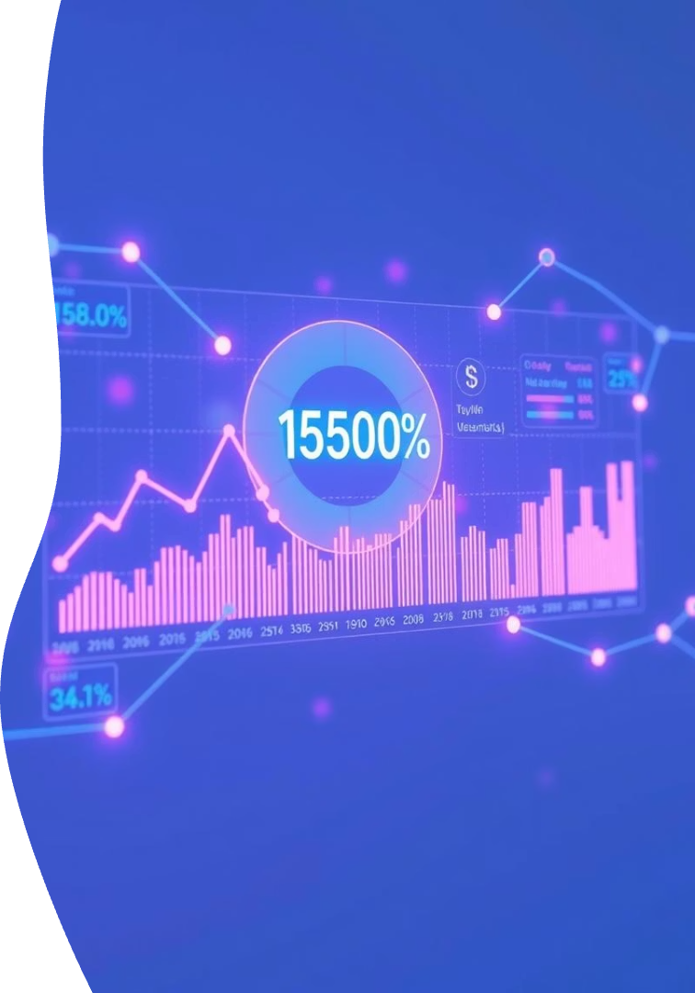

Predicting Income Using Online Social Data with R and Statistics AI
Welcome to our presentation on a groundbreaking approach to income prediction using social media behavioral data. Our team STAT-IV-T042 has developed a machine learning model that can classify income levels without relying on traditional financial or census data.
This project leverages R programming and statistical AI to analyze structured behavioral indicators from social media, providing a fast, scalable, and privacy-respecting alternative to conventional income prediction methods.
Notes:
1

Slide 2

Project Objective & Overview
The Challenge
Our Solution
Traditional income prediction relies on financial or census data that is often outdated, hard to access, or invasive to privacy.
A machine learning model that predicts income.
Key Benefits
Non-invasive data collection, rapid analysis, and scalable implementation without requiring sensitive financial information.
Our approach transforms readily available social media behavioral patterns into valuable income predictions without analyzing text content or requiring financial disclosures, making it both effective and respectful of user privacy.
Notes:
2

Slide 3





Technology Stack & Features
R Programming
ML Algorithms
Data Sources
Primary language for data analysis, statistical modeling, and machine learning implementation.
Decision Trees, k-Nearest Neighbors, and Logistic Regression for classification tasks.
Anonymized or simulated social media behavioral metrics, ensuring privacy compliance.
Development
R Studio with visualization libraries for model development and testing.
Our technology stack combines powerful statistical tools with privacy-focused data handling to create a robust prediction system that can be easily deployed and scaled.
Notes:
3

Slide 4
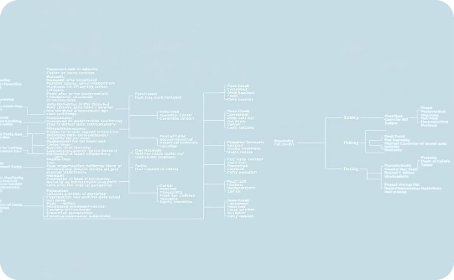
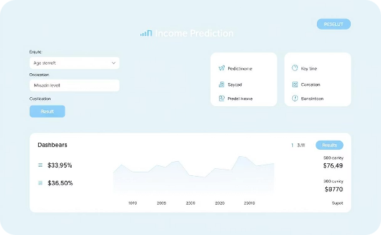
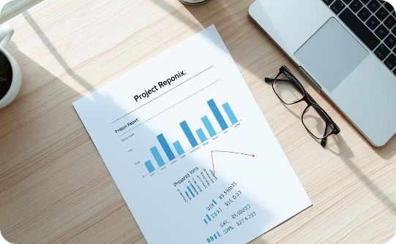
Deliverables
Trained Prediction Model
Interactive Web Demo
Comprehensive Report
A fully optimized machine learning model capable of accurately classifying income levels based on social media behavioral patterns.
A user-friendly web application that allows for real-time income predictions using social media metrics.
Detailed documentation of methodology, findings, and performance metrics, including statistical validation of results.
These deliverables represent the complete package of our income prediction solution, providing both the technical implementation and the documentation needed for understanding and further development.
Notes:
7

Slide 5





Project Workflow
Data Collection & Cleaning
Gathering and preprocessing social media behavioral data
Feature Engineering
Creating meaningful variables from raw metrics
Model Training
Developing and optimizing prediction algorithms
Evaluation & Tuning
Testing performance and refining the model
Web Interface Development
Creating an interactive prediction tool
Our workflow transforms raw social media data into actionable income predictions through a systematic process of collection, engineering, training, evaluation, and deployment, ensuring both accuracy and usability.
Notes:
4

Slide 6








Data Features & Output
Posting Frequency
Engagement Metrics
Temporal patterns of content sharing
Likes, comments, and shares received
Followers Count
Interaction Rates
Total number and growth rate of social connections
Patterns of communication with other users
Our model analyzes these behavioral indicators to classify users into three income categories: low, medium, or high. By focusing on patterns rather than content, we maintain user privacy while achieving accurate predictions.
Notes:
5

Slide 7
Timeline & Milestones
Weeks 1-2
1
Data collection and cleaning: Gathering social media metrics and preparing datasets for analysis
2
Weeks 3-4
Feature engineering: Transforming raw data into meaningful predictive variables
Week 5
3
Model training: Implementing and training multiple machine learning algorithms
4
Week 6
Evaluation and performance tuning: Testing accuracy and optimizing model parameters
Weeks 7-8
5
Web interface development, final testing, documentation, and reporting
Our eight-week development schedule ensures thorough implementation of each project phase, with clear milestones to track progress and maintain accountability throughout the development lifecycle.
Notes:
6

Slide 8



Team & Responsibilities
Suhani Aswal (Team Lead)
1
Project coordination, workflow design, documentation review
2
Shraddha Sharma
Data preprocessing, feature engineering, statistical analysis
Saurabh Parihar
3
Machine learning implementation, web interface, performance evaluation
Our team brings together complementary skills in project management, data science, and software development. This balanced approach ensures that all aspects of the project—from data handling to user interface design—receive expert attention.
Thank you for your attention! We welcome any questions about our income prediction project.
Notes:
8

Slide 9
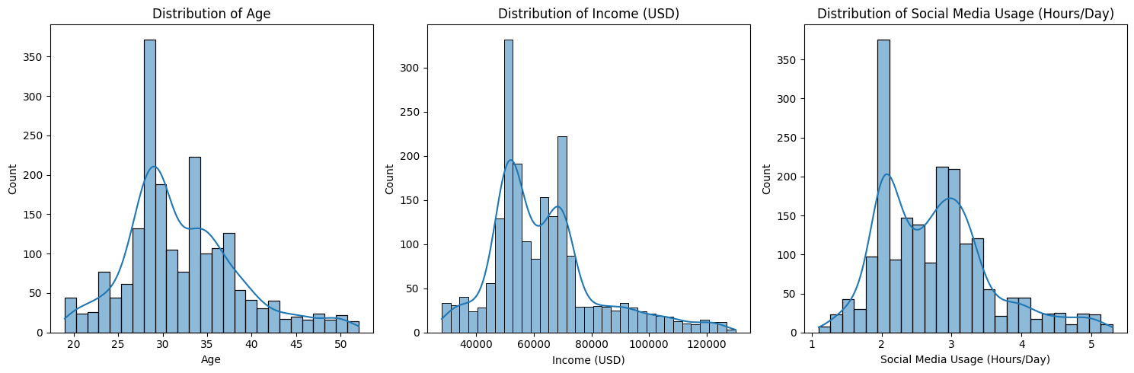
Age, Income & Social Media Usage Patterns
We found after our analysis that the individuals in our dataset are predominantly younger (peaking around 30 years old) with typical incomes between $50,000 and $70,000, and that distinct patterns in social media usage (around 2 and 3 hours/day) suggest different user segments.
"We found after our analysis that social media usage doesn't follow a single trend; instead, it clusters around two distinct daily averages (approx. 2 and 3 hours), with fewer individuals at the extreme ends of very low or very high usage.

Slide 10
Technical progress
Exploratory Data Analysis
Prediction Model Development
GUI Development
Conducted comprehensive EDA to understand data distributions, identify correlations between variables like age, income, and social media usage, and analyze categorical features such as education level and product category preferences.
Developed and optimized a Random Forest Regressor model to predict income, incorporating feature engineering (e.g., platform counts, usage intensity), achieving an R² score of 0.85 after hyperparameter tuning with GridSearchCV.
The user interface for interacting with the prediction model is planned and pending development.

